Slide 1
Quick Connect’s Proposed Claim Constructions
IP Litigation, 4 April 2024

Slide 2
Substantially U-Shaped
Aero Video: “open-ended cross section with two parallel lines joined by a central curvature.” | Quick Connect: Plain and ordinary meaning
 | U U U U U U U U U U U U U U U U U U U U U

Slide 3
Not “substantially U-shaped” per Aero Video’s Construction

Slide 4
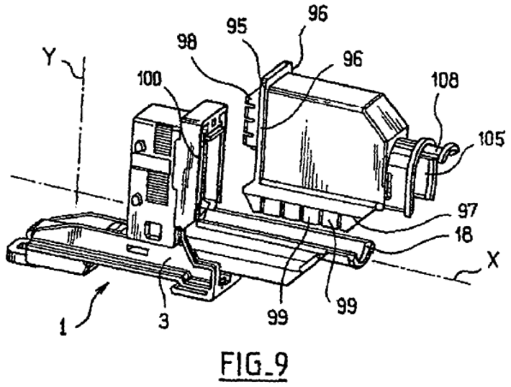
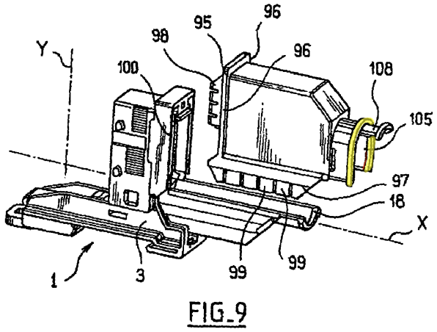
“Substantially U-Shaped”

Slide 5
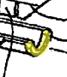
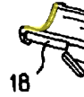
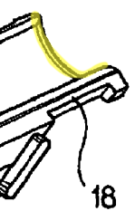
“Substantially U-shaped in the ‘312 Patent

Slide 6
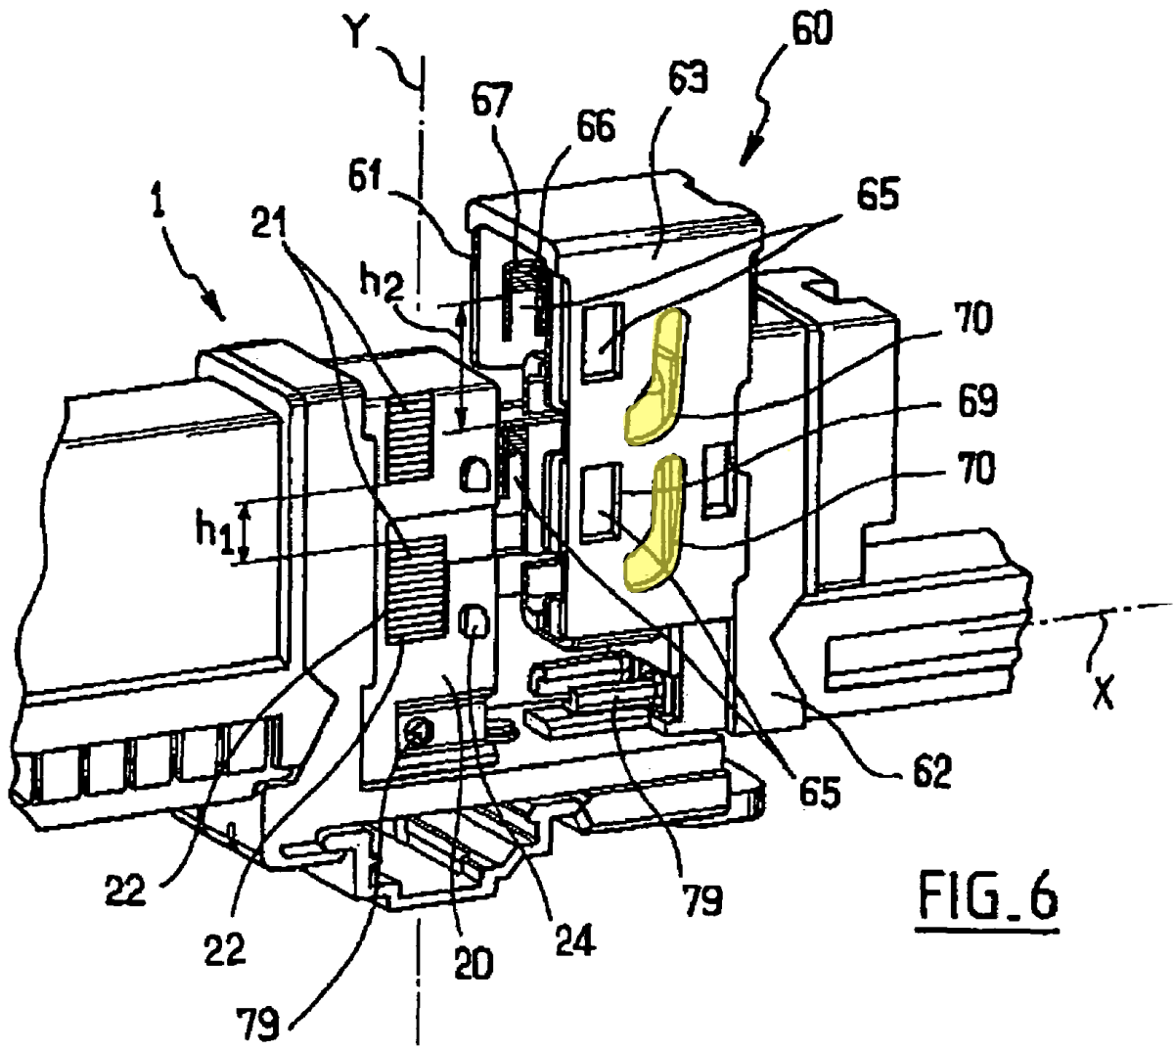
“Substantially L-shaped”
L

Slide 7
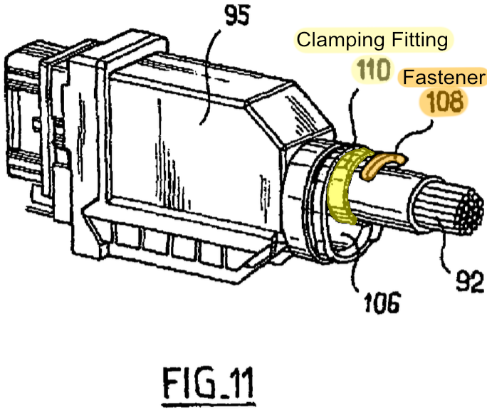
A “mechanical fitting, typically in a circular shape, that physically compresses parts together”

